Slide 1
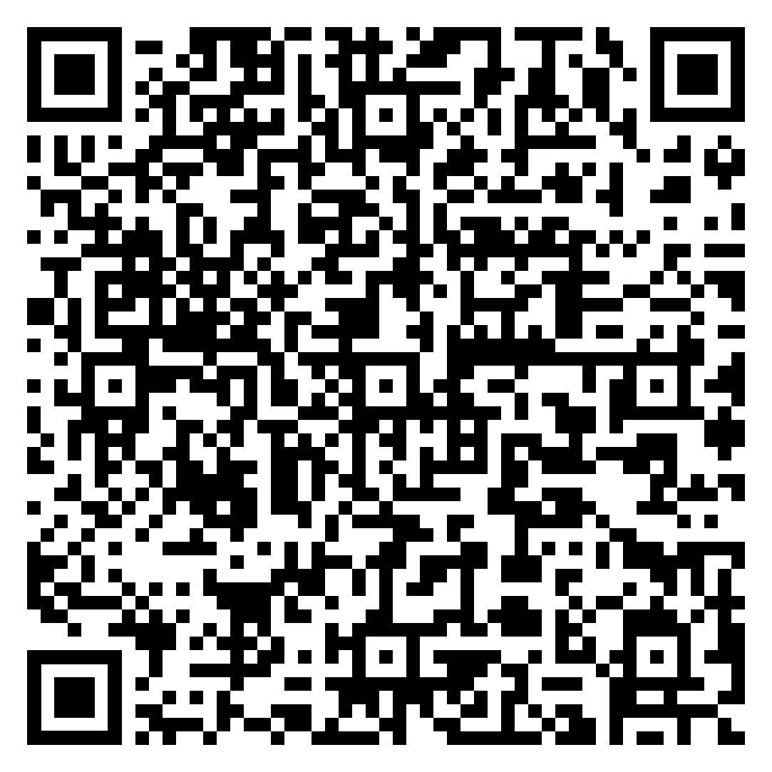
TATACARA PERMOHONAN PERMIT IMPORT BAGI PERSENDIRIAN SEMASA SITUASI COVID-19
https://bit.ly/3t4TtYo

Slide 2
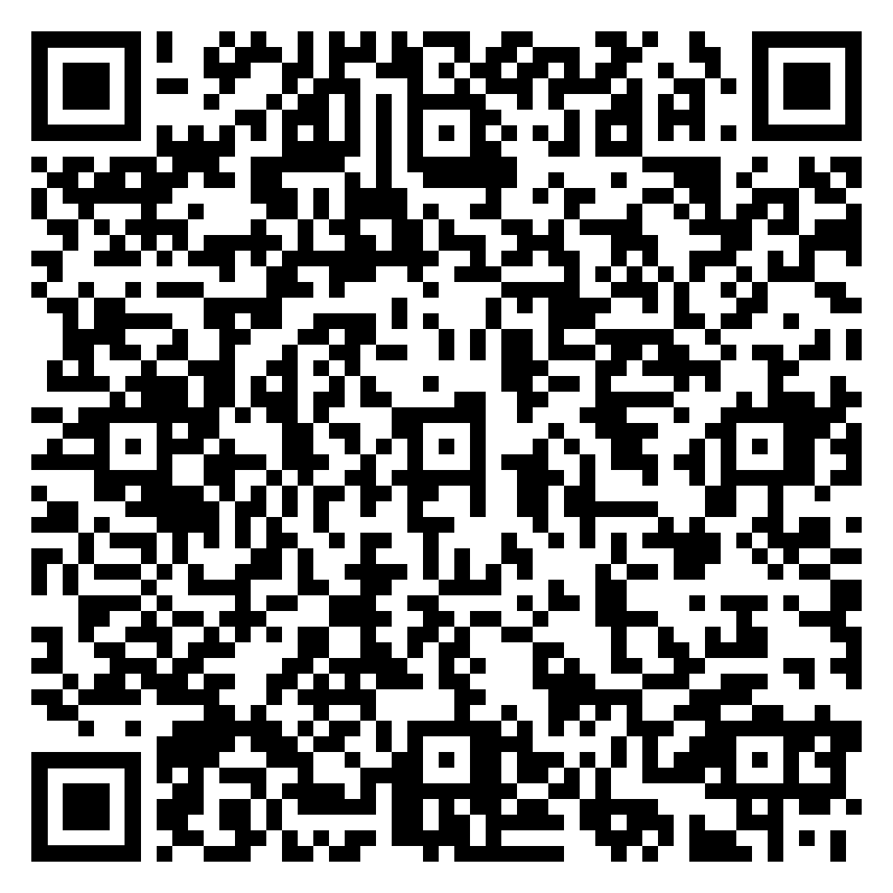
GUIDELINES ON APPLICATION FOR INDIVIDUAL IMPORT PERMIT DURING COVID-19 SITUATION
https://bit.ly/3Ie0nkt

